Slide 1
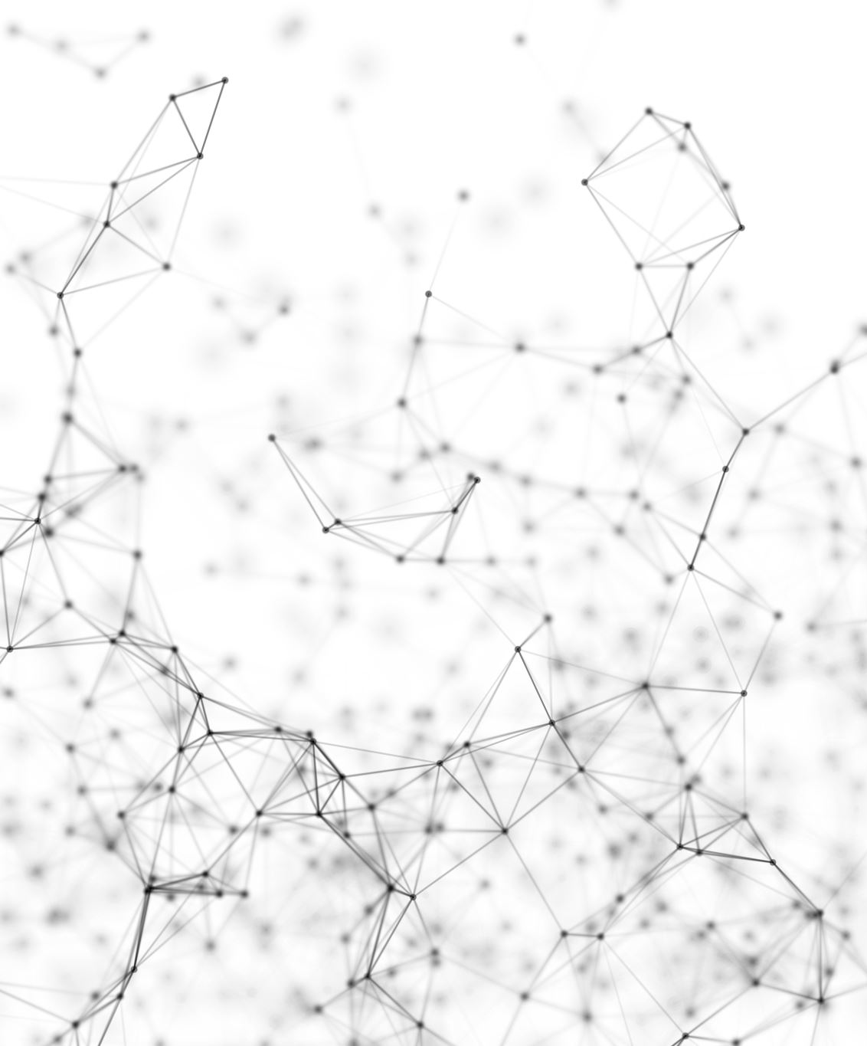
Breast tissue reconstruction
Segmentation and 3D reconstruction of a human breast tissue using deeplearning
By Noah Hoogenboom

Slide 2
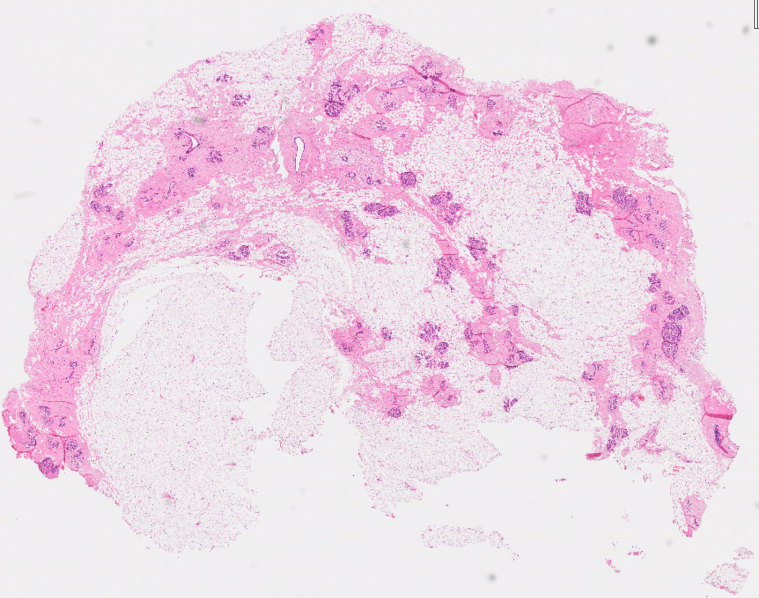
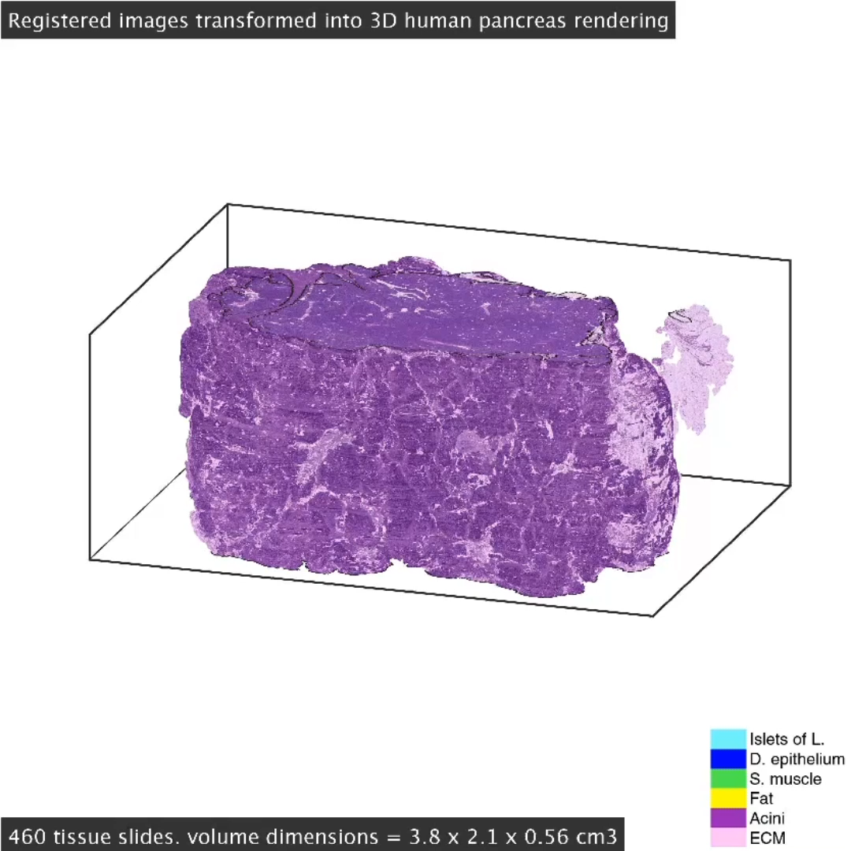
Objective
Breast Images
Image Alignment
Cell classification
3D-reconstruction
CODA based pipeline

Slide 3
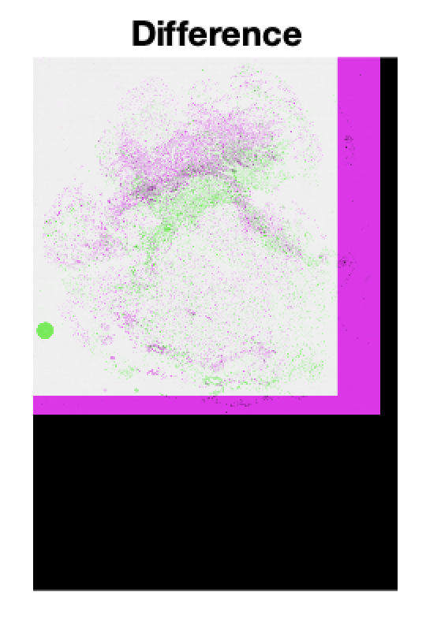
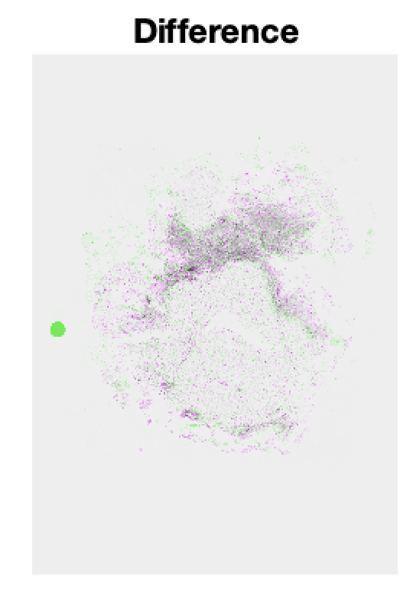
Image alignment
Global registration
Radon transformation
Cross correlation
Improvements: Log-polar or SIFT (RANSAC)
Local registration
Grid interpolation
Improvements: Gauss-Newton or Levenberg-Marquardt
RMSE: 9.3

Slide 4
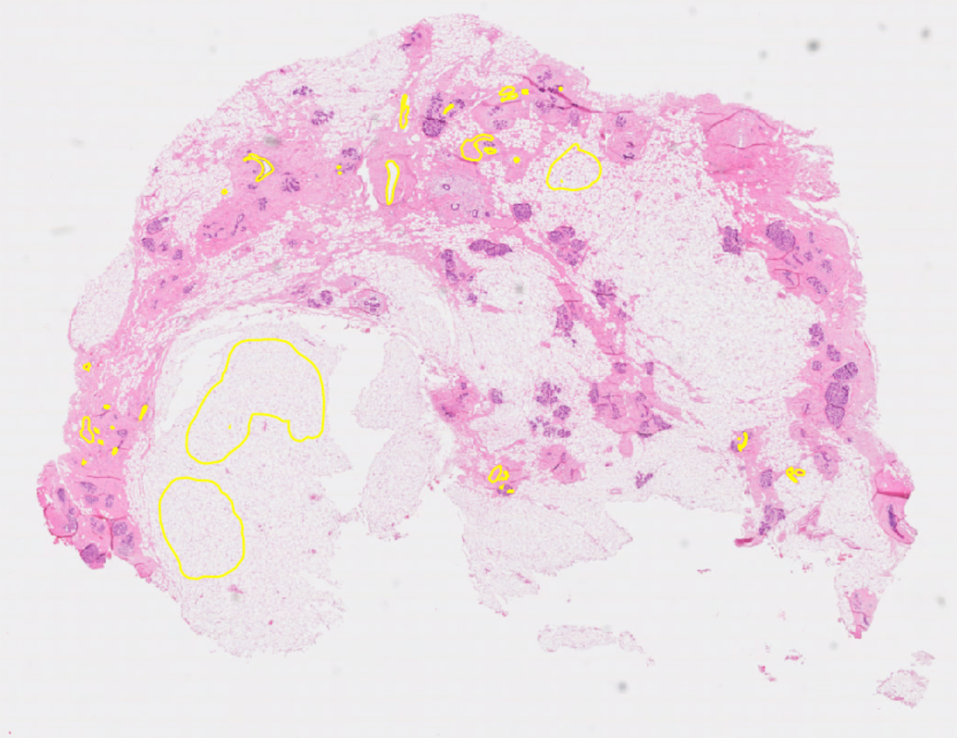
Cell Detection
Annotated areas
ResNet50
Precision: 0.929
Recall: 0.913
Improvements: R-CNN or FCN

Slide 5
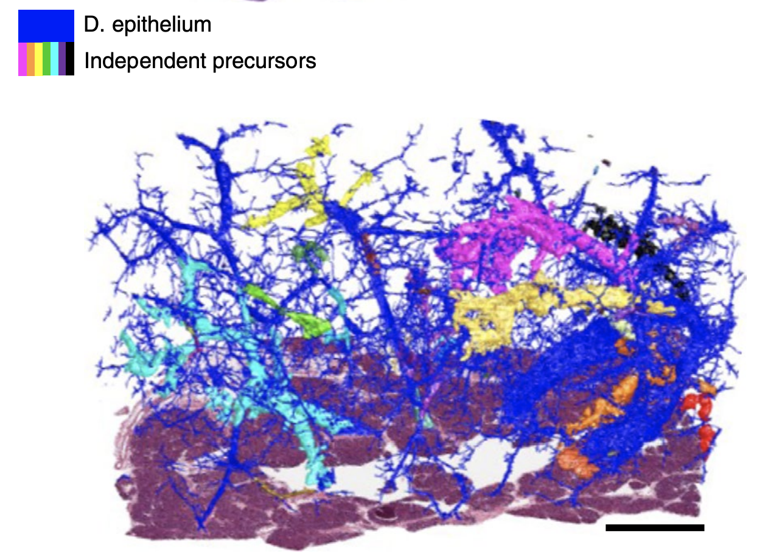
3D-reconstruction
Binary 3D matrix
Creating binary matrix

Slide 6
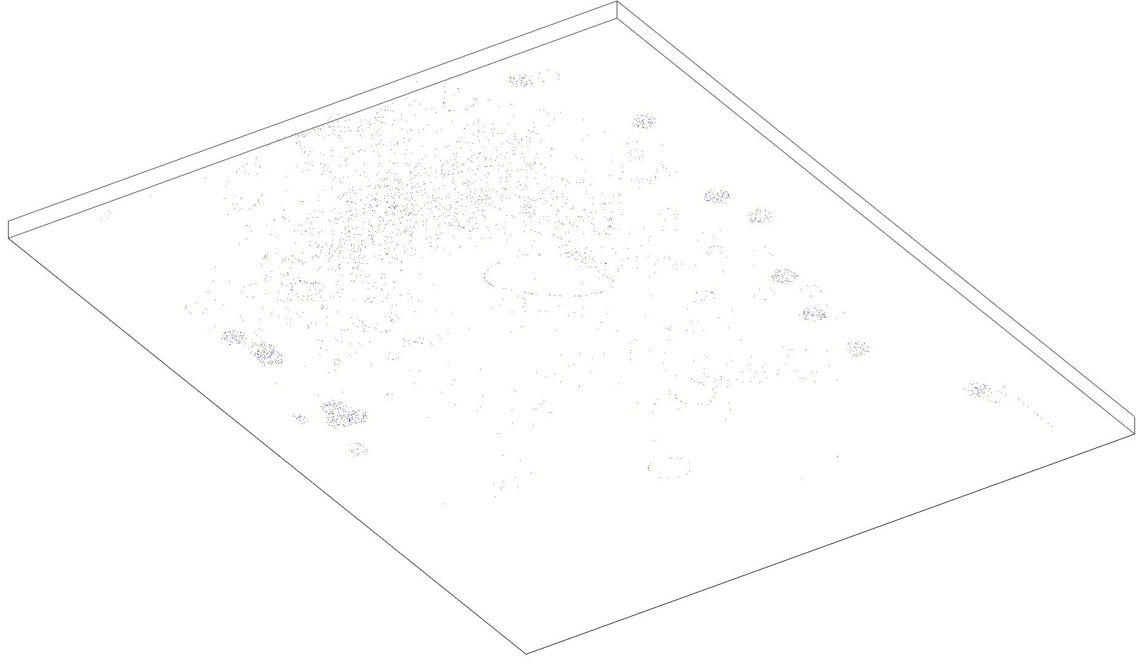
Results
Pipeline:
Image alignment (with metric)
Peak detection
3D-image
Improvements:
Set-up
No local alignment

Slide 7
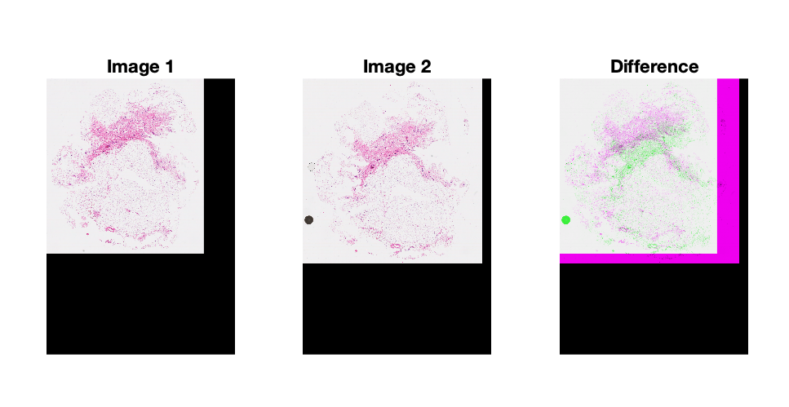
Ssim: 0.5639
RMSE: 70.51

Slide 8
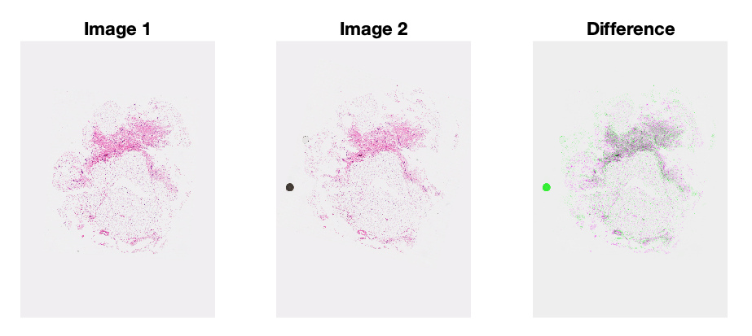
Ssim: 0.7306
RMSE: 21.05

Slide 9
Ssim: 0.7321
RMSE: 20.83

Slide 10
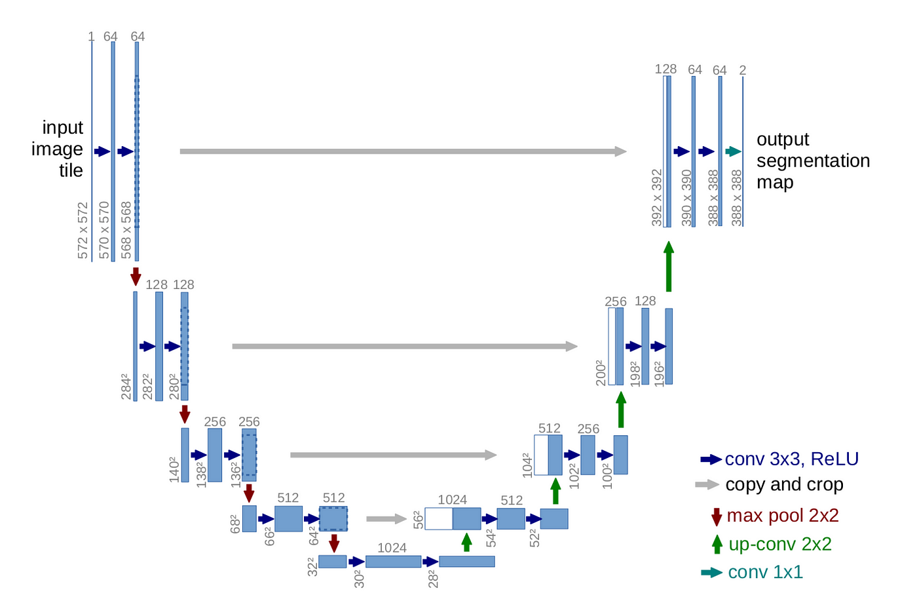
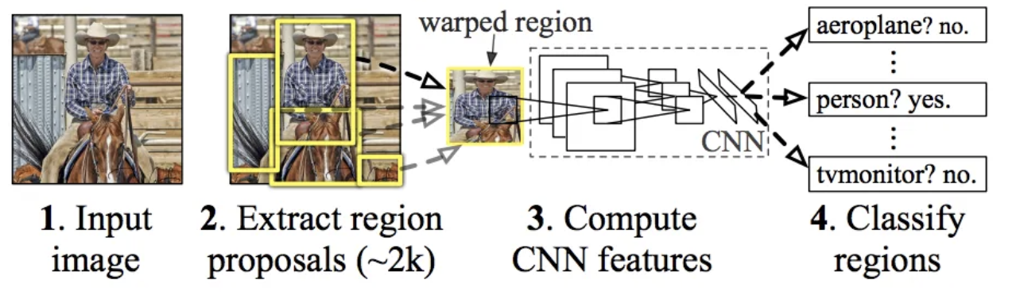
Plan
ResNet50
SIFT and Log-Polar
FCN and R-CNN
Complete pipeline

Slide 11
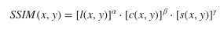
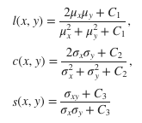
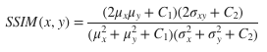
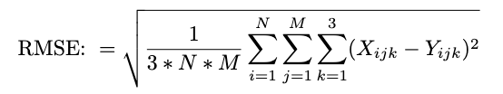
Ssim:

Slide 12
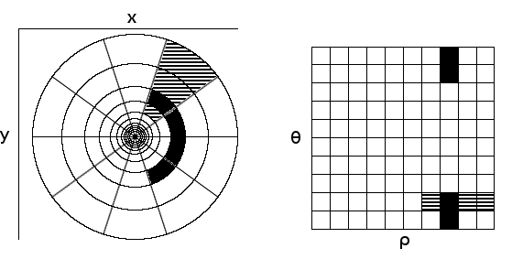
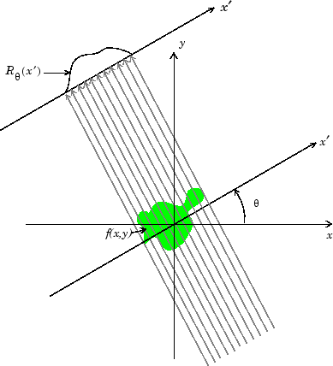
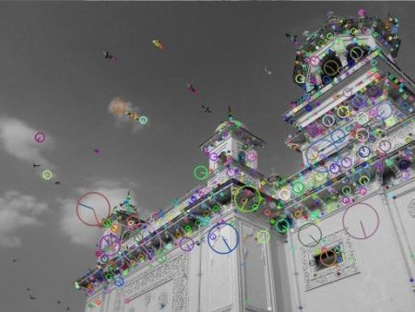
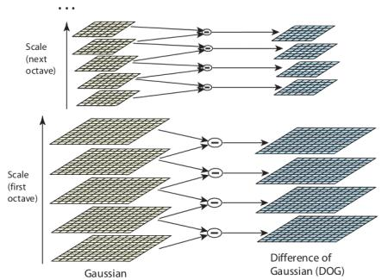

Slide 13
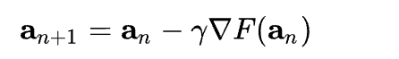
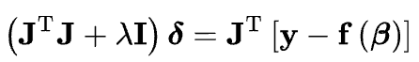
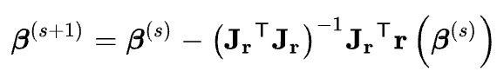
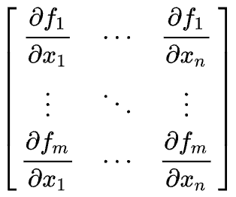
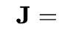
Gradient descent:
Levenberg-Marquardt:
Gauss-Newton:

